Slide 1
Lecture 8, 9
Dr. Mohammed Abdul Baset
Buffer solutions
Buffers:
1. Resist changes in pH.
2. Are prepared by mixing a weak acid with its salt or by partly neutralizing a weak acid with strong base.
3. Allow living organisms to exist.
4. Are necessary for understanding acid base titrations.
5. Offer an unrivaled opportunity to use the Henderson-Hasselbalch equation.
Acidic buffer solutions
> An acidic buffer solution is simply one which has a pH less than 7.
> Acidic buffer solutions are commonly made from a weak acid and one of its salts - often a sodium salt.
> In this case, if the solution contained equal molar concentrations of both the acid and the salt, it would have a pH of 4.76.
> An acid buffer is a mixture of weak acid and its salt with a strong base.
> Ex: 1. Acetic acid & sodium acetate (CH3COOH + CH3COONa)
2. Formic acid & potassium formate (HCOOH + HCOOK)
3. Benzoic acid and & sodium benzoate (C₆H₅COOH + C₆H₅COONa)
4. Phosphoric acid & Sodium phosphate (H₃PO₄ + Na₃PO₄)
Alkaline buffer solutions
> An alkaline buffer solution has a pH greater than 7.
> Alkaline buffer solutions are commonly made from a weak base and one of its salts.
> If these were mixed in equal molar proportions, the solution would have a pH of 9.25.
> Ex: ammonium hydroxide & ammonium chloride (NH₄OH + NH₄Cl)
Requirements for buffer solution:
There are three requirements for buffer:
• Must be a mixture of weak acid and its salt or weak base and its salt
• A buffer must contain relatively large concentration of acid to react with added base (OH⁻) and also must contain similar concentration of base to reaction with added acid (H⁺).
• The acid and base components of the buffer must not consume each other in a neutralization reaction.
Preparation of Buffer Solution
A buffer solution is prepared by mixing equal amount of weak acid and its salt, such as, acetic acid (CH₃COOH) and sodium acetate (CH₃COONa) or weak base and its salt, such as, ammonia (NH₃) and ammonium chloride (NH₄Cl).
44

Slide 2
Types of buffers
A buffer solution is a solution the pH of which does not change significantly when a small amount of acid or base is added to it. There are four categories of buffers.
1. Strong acid buffers
2. Strong base buffers
3. Weak acid buffers
4. Weak base buffers
Example:
Which of the following are buffer systems?
(a) KF/HF
(b) KBr/HBr
(c) Na2CO3/NaHCO3
(d) NaClO4/HClO4
(e) NH3/NH4NO3
45

Slide 3
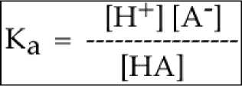
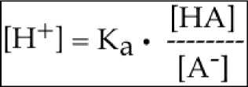
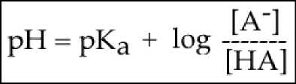
Answer
(a) HF is a weak acid and KF is its salt. Therefore, this is a buffer system.
(b) HBr is a strong acid and hence this is not a buffer system.
(c) NaHCO₃ contains a weak acid (HCO₃⁻) and Na₂CO₃ is a salt of weak acid. Therefore, this is a buffer system.
(d) HClO4 is a strong acid and hence this is not a buffer system.
NH3 is a weak base and NH4NO3 is a salt of weak base, and therefore this is a buffer system.
The pH of Buffer Solutions
The Henderson-Hasselbalch Equation is: (1) a rearrangement of the K_{a} expression followed by (2) the use of negative logarithms. We will derive the HH equation using the generic weak acid HA.
Here is the dissociation equation for HA:
HA <===> H⁺ + A⁻
From which, we write the Ka expression:
Next, we isolate the H+ and put it on the left-hand side of the equation:
Now, we going to take the negative log of each of the three terms in the above equation. When I do that, they become:
1) -log [H+]
2) - log Ka
3) -log ([HA] / [A⁻])
However,
1) this is the pH
2) this is the pKa
3) to get rid of the negative sign, we simply flip the log term to get this: + log ([A ] / [HA])
Inserting these last three items (the pH, the pKa and the rearranged log term), we arrive at the Henderson-Hasselbalch Equation:
Here is a common way the HH equation is presented in a textbook explanation:
46

Slide 4
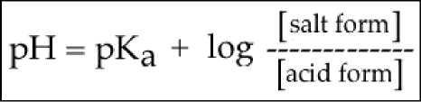
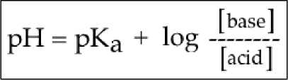
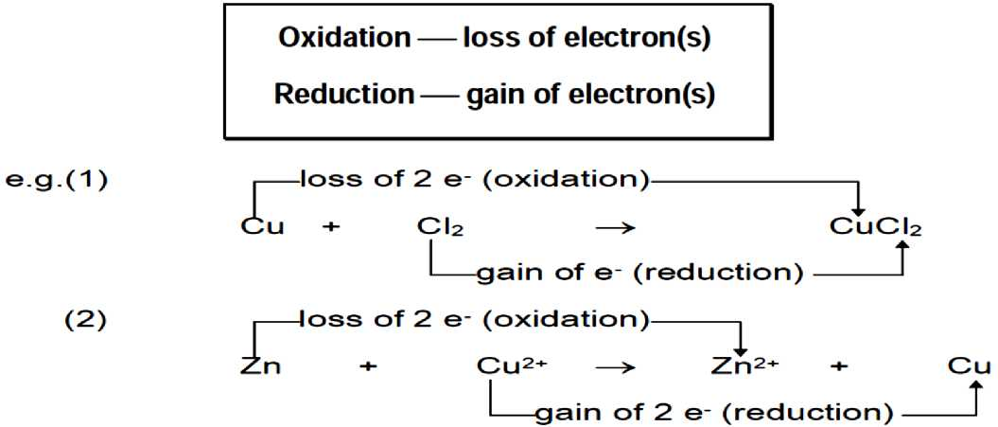
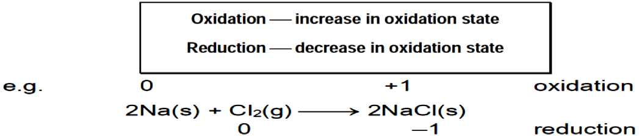
However, remember that the salt of a weak acid is a base (and the salt of a weak base is an acid).
Consequently, another common way to write the HH equation is to substitute "base" for "salt form". This is probably the most useful way to decribe the interactions between the acidic form (the HA) and the basic form (the A⁻)
Here it is:
Remember this: the base is the one WITHOUT the proton and the acid is the one WITH the proton.
Redox Reactions
1. Redox reactions in terms of electron transfer
2. Redox reactions in terms of oxidation number
47

Slide 5
48

Slide 6
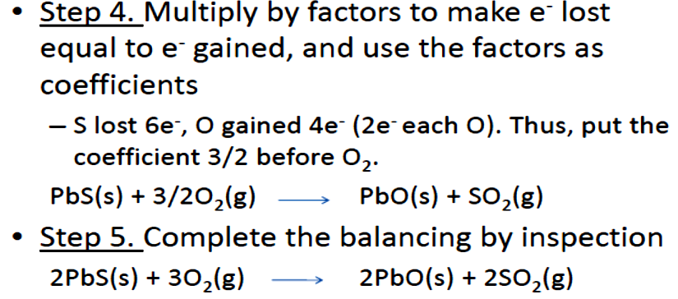
Balancing Redox Reactions Using the Half Reaction Method
Example -- Balancing Redox Reactions Which Occur in Acidic Solution
Organic compounds, called alcohols, are readily oxidized by acidic solutions of dichromate ions. The following reaction, written in net ionic form, records this change. The oxidation states ofeach atom in each compound is listed in order to identify the species that are oxidized and reduced, respectively.
Cr₂0 t²- + C₂H₆0 —► Cr³⁺ + C₂H₄0
dichromate ethanol chromium(IH) acetaldehyde
An examination of the oxidation states, indicates that carbon is being oxidized, and chromium, is being reduced. To balance the equation, use the following steps:
1. First, divide the equation into two halves; one will be an oxidation half-reaction and the other a reduction half- reaction, by grouping appropriate species. The nature of each will become evident in subsequent steps.
2. Second, if necessary, balance all elements except oxygen and hydrogen in both equations by inspection. In other words, balance the non-hydrogen and non-oxygen atoms only. By following this guideline in the example above, only the chromium reaction needs to be balanced by placing the coefficient, 2 , in front of Cr+³ as shown below.
3. The third step involves balancing oxygen atoms. To do this, add water (H₂O) molecules. Use 1 molecule of water for each oxygen atom that needs to be
49

Slide 7
50

Slide 8
8 H⁺ + Cr₂0₇²- + 3 C₂H₆0 —► 2 Cr³⁺ + 7 H₂0 + 3 C₂H₄0
Note: the equation above is completely balanced in terms of having an equal number of atoms as well as charges.
51

